Slide 1

KS3 Mathematics
D4 Calculating probability
Notes:
The aim of this unit is to teach pupils to:
Use the vocabulary of probability
Use the probability scale; find and justify theoretical probabilities
Collect and record experimental data, and estimate probabilities based on the data
Compare experimental and theoretical probabilities
Material in this unit is linked the Framework’s supplement of examples pp276–285.

Slide 2


Listing possible outcomes
When you roll a fair dice you are equally likely to get one of six possible outcomes:
1
1
1
1
1
1
6
6
6
6
6
6
Since each number on the dice is equally likely the probability of getting any one of the numbers is 1 divided by 6 or .
1
6
Notes:
Explain that the word ‘fair’ or ‘unbiased’ means that each outcome is equally likely. Some dice are ‘weighted’. That means that the weight of the dice is unevenly distributed and some numbers are more likely to appear than others.
The probability of getting any number is 1 (certain) so the probability of getting each different number is 1 ÷ 6 or ¹/₆.

Slide 3
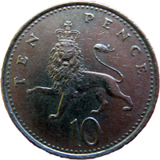
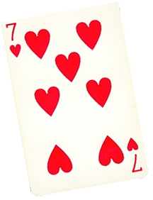
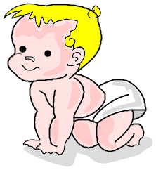
Calculating probability
What is the probability of the following events?
1) A coin landing tails up?
3) Drawing a seven of hearts
from a pack of 52 cards?
1
P(tails) =
1
2
P(7 of ) =
52
2) This spinner stopping on
the red section?
4) A baby being born on a
Friday?
1
1
P(red) =
P(Friday) =
4
7
Notes:
For each example ask pupils to tell you the number of equally likely outcomes before revealing the probability.
Introduce the notation of P(n) for the probability of an event n.

Slide 4
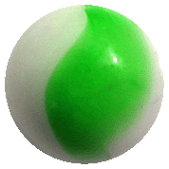
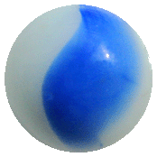
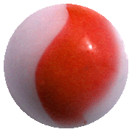
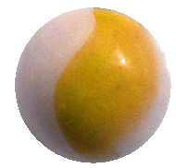
Calculating probability
If the outcomes of an event are equally likely then we can calculate the probability using the formula:
Number of successful outcomes
Probability of an event =
Total number of possible outcomes
For example, a bag contains 1 yellow, 3 green, 4 blue and 2 red marbles.
What is the probability of pulling a green marble from the bag without looking?
3
P(green) =
or 0.3
or 30%
10
Notes:
Point out that calculated probabilities are usually given as fractions but that they can also be given as decimals and (less often) as percentages.
Ask pupils to give you the probabilities (as decimals, fractions and percentages) of getting
a blue marble
a red marble
a yellow marble
a purple marble
a blue or a green marble, etc.

Slide 5
Calculating probability
This spinner has 8 equal divisions:
What is the probability of the spinner landing on
a red sector?
a blue sector?
a green sector?
2
1
a) P(red) =
=
8
4
1
b) P(blue) =
8
4
1
c) P(green) =
=
8
2

Slide 6
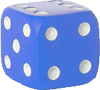
Calculating probability
A fair dice is thrown. What is the probability of getting
a 2?
a multiple of 3?
an odd number?
a prime number?
a number bigger than 6?
an integer?
1
a) P(2) =
6
2
1
b) P(a multiple of 3) =
=
6
3
3
1
c) P(an odd number) =
=
6
2

Slide 7
Calculating probability
A fair dice is thrown. What is the probability of getting
a 2?
a multiple of 3?
an odd number?
a prime number?
a number bigger than 6?
an integer?
3
1
d) P(a prime number) =
=
0
6
2
Don’t write
6
e) P(a number bigger than 6) =
0
6
f) P(an integer) =
= 1
6

Slide 8
Calculating probability
The children in a class were asked how many siblings (brothers and sisters) they had. The results are shown in this frequency table:
Number of siblings
0
1
2
3
4
5
6
7
Number of pupils
4
8
9
4
3
1
0
1
What is the probability that a pupil chosen at random from the class will have two siblings?
There are 30 pupils in the class and 9 of them have two siblings.
9
3
So, P(two siblings) =
=
30
10

Slide 9
Calculating probability
A bag contains 12 blue balls and some red balls.
The probability of drawing a blue ball at random from the
bag is .
How many red balls are there in the bag?
3
7
3
12 balls represent of the total.
7
1
So, 4 balls represent of the total
7
7
and, 28 balls represent of the total.
7
The number of red balls = 28 – 12 =
16
Notes:
Reason that if the probability of drawing a blue ball at random is ³/₇, then ³/₇ of the balls must be blue.
To find the total number of balls we must divide the number of blue balls by 3 and multiply by 7 to get 28. The number of red balls is then found by subtracting 12 from 28 to get 16.
Discuss alternative methods to calculate this using proportional reasoning or algebra.

Slide 10
The probability of an event not occurring
The following spinner is spun once:
What is the probability of it landing on the yellow sector?
1
P(yellow) =
4
What is the probability of it not landing on the yellow sector?
3
P(not yellow) =
4
If the probability of an event occurring is p then the probability of it not occurring is 1 – p.
Notes:
Two probabilities that add up to one are sometimes called complementary probabilities (compare with number complements).

Slide 11
The probability of an event not occurring
The probability of a factory component being faulty is 0.03. What is the probability of a randomly chosen component not being faulty?
P(not faulty) = 1 – 0.03 =
0.97
The probability of pulling a picture card out of a full deck of
cards is .
What is the probability of not pulling out a picture card?
3
13
3
10
P(not a picture card) = 1 – =
13
13

Slide 12
The probability of an event not occurring
The following table shows the probabilities of 4 events. For each one work out the probability of the event not occurring.
Probability of the event occurring
Probability of the event not occurring
Event
3
2
A
5
5
B
0.77
0.23
9
11
C
20
20
D
8%
92%

Slide 13
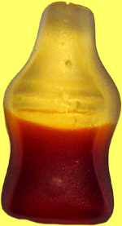
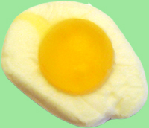

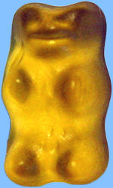
The probability of an event not occurring
There are 60 sweets in a bag.
1
10 are cola bottles,
are fried eggs,
4
20 are hearts,
the rest are teddies.
What is the probability that a sweet chosen at random from the bag is:
5
a) Not a cola bottle
P(not a cola bottle) =
6
45
3
b) Not a teddy
P(not a teddy) =
=
60
4
Notes:
We can work out the number of sweets that are not teddies by finding the sum of 10, 20 and a ¼ of 60 to get 45.
Modify the numbers to make this problem more challenging.

Slide 14
Mutually exclusive outcomes
Outcomes are mutually exclusive if they cannot happen at the same time.
For example, when you toss a single coin either it will land on heads or it will land on tails. There are two mutually exclusive outcomes.
Outcome A: Head
Outcome B: Tail
When you roll a dice either it will land on an odd number or it will land on an even number. There are two mutually exclusive outcomes.
Outcome A: An odd number
Outcome B: An even number
Notes:
Outcomes are mutually exclusive if we can either have one or the other but not both. Stress that if we can use either … or … when describing two or more outcomes then they are probably mutually exclusive.

Slide 15
Mutually exclusive outcomes
A pupil is chosen at random from the class. Which of the following pairs of outcomes are mutually exclusive?
Outcome A: the pupil has brown eyes.
Outcome B: the pupil has blue eyes.
These outcomes are mutually exclusive because a pupil can either have brown eyes, blue eyes or another colour of eyes.
Outcome C: the pupil has black hair.
Outcome D: the pupil has wears glasses.
These outcomes are not mutually exclusive because a pupil could have both black hair and wear glasses.

Slide 16
Adding mutually exclusive outcomes
If two outcomes are mutually exclusive then their probabilities can be added together to find their combined probability.
For example, a game is played with the following cards:
What is the probability that a card is a moon or a sun?
1
1
P(moon) =
and
P(sun) =
3
3
Drawing a moon and drawing a sun are mutually exclusive outcomes so,
1
1
2
P(moon or sun) = P(moon) + P(sun) =
+
=
3
3
3
Notes:
Ask pupils to tell you the probability of getting a crescent card or a star card.
Reveal the solution on the board.
Stress that only events that are mutually exclusive can be added in this way. For example, If we are drawing a card at random from a pack P(King) = 4/52, P(Club) = 13/52, but P(King or club) ≠ 4/52 + 13/52 because a card could be both a king and a club.

Slide 17
Adding mutually exclusive outcomes
What is the probability that a card is yellow or a star?
1
1
P(yellow card) =
and
P(star) =
3
3
Drawing a yellow card and drawing a star are not mutually exclusive outcomes because a card could be yellow and a star.
P (yellow card or star) cannot be found simply by adding.
We have to subtract the probability of getting a yellow star.
1
1
1
3 + 3 – 1
5
P(yellow card or star) =
+
–
=
=
3
3
9
9
9
Notes:
Ask pupils to tell you the probability of getting a yellow card or a star card. Stress that this cannot be found by adding.
The probability is ⁵/₉ because one of the cards is both yellow and a star.

Slide 18
The sum of all mutually exclusive outcomes
The sum of all mutually exclusive outcomes is 1.
For example, a bag contains red counters, blue counters, yellow counters and green counters.
P(blue) = 0.15
P(yellow) = 0.4
P(green) = 0.35
What is the probability of drawing a red counter from the bag?
P(blue or yellow or green) = 0.15 + 0.4 + 0.35 =
0.9
P(red) = 1 – 0.9 =
0.1
Notes:
Explain that when we draw a counter from the bag it is either red, blue, yellow or green. These outcomes are therefore mutually exclusive, there are no other possible outcomes and so their combined probabilities must equal 1.
Mutually exclusive outcomes can be added together.
The decimals on this slide can be changed to make the problem more challenging.

Slide 19
The sum of all mutually exclusive outcomes
A box contains bags of crisps. The probability of drawing out the following flavours at random are:
2
1
P(salt and vinegar) =
P(ready salted) =
5
3
The box also contains cheese and onion crisps.
What is the probability of drawing a bag of cheese and onion crisps at random from the box?
2
1
6 + 5
11
P(salt and vinegar or ready salted) =
+
=
=
5
3
15
15
11
4
P(cheese and onion) = 1 –
=
15
15
Notes:
Pupils may need to revise the addition of fractions with different denominators to complete this question. See N6.1 Adding and subtracting fractions.
Explain that when we draw a packet of crisps from the box it is either salt and vinegar, cheese and onion or ready salted. These outcomes are therefore mutually exclusive. There are no other possible outcomes and so their combined probabilities must equal 1.

Slide 20
The sum of all mutually exclusive outcomes
A box contains bags of crisps. The probability of drawing out the following flavours at random are:
2
1
P(salt and vinegar) =
P(ready salted) =
5
3
The box also contains cheese and onion crisps.
There are 30 bags in the box. How many are there of each flavour?
Number of salt and vinegar =
2
of 30 =
12 packets
5
1
Number of ready salted =
of 30 =
10 packets
3
4
Number of cheese and onion =
of 30 =
8 packets
15
Notes:
Pupils may need to revise finding fractions of amounts to complete this question. See N6.2 Finding a fraction of an amount.
Explain that the probability relates to the proportion of each flavour. If we know the probability of getting each flavour and the number of bags altogether, then we can use this information to work out the number of each flavour.

